Slide 1

Academic Session 2025-26
Even Semester Jan-May 2025
UNIVERSITY INSTITUTE OF ENGINEERING
AIT-CSE (AIML)
CS221: B.E. CSE (AIML)
6th Semester
ADVANCED MACHINE LEARNING & MATHEMATICAL MODELLING
(23CSH-382)
Unit No. 1 Chapter No. 1 Lecture No. 14 & 15
Topic: Normal Distribution, T Distributions, RSE and R2
Mr. Siddharth Kumar (E12853) Assistant Professor

Slide 2
COURSE OBJECTIVES
1
The course aims to:
To develop a strong mathematical foundation for regression-based predictive modelling using calculus, matrix algebra, and probability theory.
To provide an in-depth understanding of supervised classification algorithms including KNN, Support Vector Machines, and ensemble-based boosting approaches.
To equip learners to implement clustering and probabilistic reasoning models such as Spectral Clustering, Markov Chains, Bayesian Networks, and HMMs.
To cultivate the ability to design neural networks, implement multilayer perceptron, and optimize training using backpropagation and regularization strategies.
To expose students to advanced deep learning frameworks, feature abstraction hierarchies, and performance enhancement through hyper-parameter tuning & dropout.

Slide 3

COURSE OUTCOMES
2
On completion of this course, the students shall be able to:
CO1 | Recall the foundational concepts, terminology, and mathematical principles underlying regression, classification and clustering approaches.
CO2 | Illustrate the working mechanisms, characteristics, and theoretical concept of regression, clustering and classification techniques in machine learning.
CO3 | Apply appropriate regression, clustering and classification algorithms to solve real-world machine learning tasks while addressing performance constraints.
CO4 | Analyze and evaluate machine learning models using performance parameters to identify the best-suited techniques for specific applications regression, clustering and classification algorithms.
CO5 | Design and implement optimized machine learning solutions by integrating regression, clustering and classification models to solve complex predictive and decision-making problems.

Slide 4
Unit-I Syllabus
3
Unit-1 | Regression | Contact Hours: 15
Regression | Linear and Polynomial Regression, Maxima and Minima of Function of One Variable, Rank, Eigen Values and Eigen Vectors, Positive & Negative Definite/Semi-definite Matrices
Error Estimation | Maxima and Minima of Function of Several Variables, Convexity of Errors Function, Building Simple Linear Regression Model by Solving Normal Equations, Gradient Descent, Stochastic & Mini-batch Gradient Descent Algorithm
Probability Theory | Discrete Probability Distributions, Continuous Probability Distributions, Normal Distribution and t-Distributions, RSE, R²

Slide 5
SUGGESTIVE READINGS
4
Text Books / Reference Books:
TEXT BOOKS
T1: Massaron, L., & Boschetti, A. (2016). Regression analysis with Python. Packt Publishing Ltd.
T2: Jajuga, K., Sokolowski, A., & Bock, H. H. (Eds.). (2012). Classification, clustering, and data analysis: recent advances and applications.
T3: Bishop, C. M., & Bishop, H. (2023). Deep learning: Foundations and concepts. Springer Nature.
REFERENCE BOOKS
R1: Matloff, N. (2017). Statistical regression and classification: from linear models to machine learning. Chapman and Hall/CRC.
R2: Jajuga, K., Sokolowski, A., & Bock, H. H. (Eds.). (2012). Classification, clustering, and data analysis: recent advances and applications.
R3: Vishnoi, V. K., Chauhan, N. R., & Kumar, K. (2024). An introduction to deep learning. Xoffencer publication.

Slide 6
Table of Contents
5
Normal Distribution
T Distributions
RSE
R2

Slide 7
Normal Distribution
6
Normal Distribution is the most common or normal form of distribution of Random Variables, hence the name "normal distribution."
It is also called the Gaussian Distribution in Statistics or Probability. We use this distribution to represent a large number of random variables. It serves as a foundation for statistics and probability theory.
Normal distribution is a continuous probability distribution that is symmetric about the mean, depicting that data near the mean are more frequent in occurrence than data far from the mean.
The normal distribution is described by the mean (μ) and the standard deviation (σ). The normal distribution is often referred to as a 'bell curve’.

Slide 8
Normal Distribution
7
The normal distribution is often referred to as a 'bell curve' because of its shape:
Most of the values are around the center (μ)
The median and mean are equal
It has only one mode
It is symmetric, meaning it decreases the same amount on the left and the right of the center
The area under the curve of the normal distribution represents probabilities for the data. The area under the whole curve is equal to 1, or 100%
Here is a graph of a normal distribution with probabilities between standard deviations (σ):

Slide 9
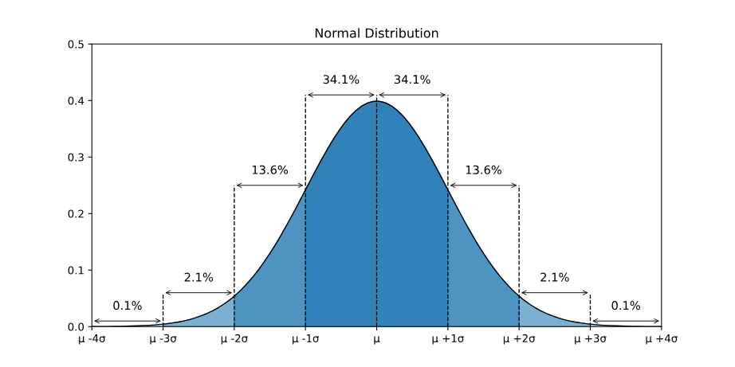
Normal Distribution
8
Roughly 68.3% of the data is within 1 standard deviation of the average (from μ-1σ to μ+1σ)
Roughly 95.5% of the data is within 2 standard deviations of the average (from μ-2σ to μ+2σ)
Roughly 99.7% of the data is within 3 standard deviations of the average (from μ-3σ to μ+3σ)
Figure-1: Normal Distribution

Slide 10
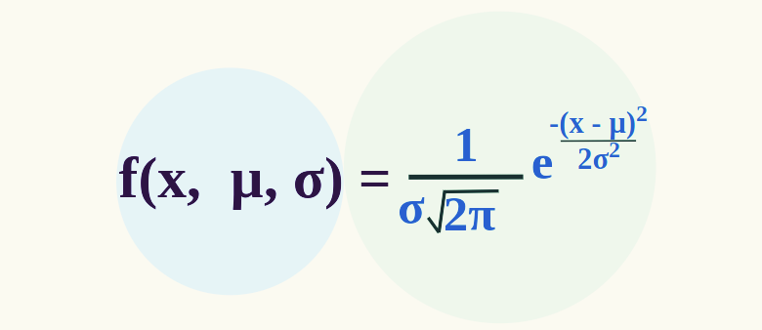
Normal Distribution
9
Normal Distribution Formula: The formula for the probability density function of the Normal Distribution (Gaussian Distribution) is added below:
Where: x is Random Variable
μ is Mean
σ is Standard Deviation
The area under the curve of a normal distribution is always 1.
The curve traced by the upper values of the Normal Distribution is in the shape of a Bell.
Figure-2: Normal Distribution Formula

Slide 11
Normal Distribution Characteristics
10
Symmetry: The normal distribution is symmetric around its mean. This means the left side of the distribution mirrors the right side.
Mean, Median, and Mode: In a normal distribution, the mean, median, and mode are all equal and located at the center of the distribution.
Bell-shaped Curve: The curve is bell-shaped, indicating that most of the observations cluster around the central peak and the probabilities for values further away from the mean taper off equally in both directions.
Standard Deviation: The spread of the distribution is determined by the standard deviation. About 68% of the data falls within one standard deviation of the mean, 95% within two standard deviations, and 99.7% within three standard deviations.

Slide 12
Normal Distribution Examples
11
We can draw a Normal Distribution for various types of data that include,
Distribution of Height of People.
Distribution of Errors in any Measurement.
Distribution of Blood Pressure of any Patient, etc.
Standard Deviation of Normal Distribution: The mean of any data spread out as a graph helps us to find the line of symmetry of the graph. Standard Deviation tells us how far the data is spread out from the mean value on either side. For smaller values of the standard deviation, the values in the graph come closer and the graph becomes narrower. For higher values of the standard deviation, the values in the graph are dispersed more, and the graph becomes wider.

Slide 13
Normal Distribution
12
Generally, the normal distribution has a positive standard deviation, and the standard deviation divides the area of the normal curve into smaller parts, and each part defines the percentage of data that falls into a specific region. This is called the Empirical Rule of Standard Deviation in Normal Distribution.
Empirical Rule states that,
68% of the data approximately fall within one standard deviation of the mean, i.e. it falls between {Mean - One Standard Deviation, and Mean + One Standard Deviation}
95% of the data approximately fall within two standard deviations of the mean, i.e. it falls between {Mean - Two Standard Deviation, and Mean + Two Standard Deviation}
99.7% of the data approximately fall within a third standard deviation of the mean, i.e. it falls between {Mean - Third Standard Deviation, and Mean + Third Standard Deviation}

Slide 14
Applications of Normal Distribution
13
Feature Scaling (Standardization) in Machine Learning
Improves the performance of algorithms like SVM, KNN, and Neural Networks.
Bayesian Inference & Probabilistic Models
Used in Gaussian Mixture Models (GMM) for clustering.
Anomaly Detection like Outliers are detected if they fall beyond μ ± 3σ and used in fraud detection, network security.
Gaussian Blurring like applies a normal-distributed kernel to smooth images and reduces noise while preserving edges.
Diffusion Models (Generative AI) like noise is added/removed in a Gaussian process (e.g., Stable Diffusion).

Slide 15
T Distribution
14
The T Distribution also called the student’s t-distribution and is used while making assumptions about a mean when we don’t know the standard deviation.
In probability and statistics, the normal distribution is a bell-shaped distribution whose mean is μ and the standard deviation is σ.
The t-distribution is similar to normal distribution but flatter and shorter than a normal distribution.
Here, we are going to discuss what is t-distribution, formula, table, properties, and applications.
The t-score indicates how many estimated standard errors the sample mean (x̄) is away from the population mean (μ).

Slide 16
T Distribution
15
T- Distribution Definition: The t-distribution is a hypothetical probability distribution. It is also known as the student’s t-distribution and used to make presumptions about a mean when the standard deviation is not known to us. It is symmetrical, bell-shaped distribution, similar to the standard normal curve. As high as the degrees of freedom (df), the closer this distribution will approximate a standard normal distribution with a mean of 0 and a standard deviation of 1.
T Distribution Formula: A t-distribution is the whole set of t values measured for every possible random sample for specific sample size or a particular degree of freedom. It approximates the shape of normal distribution.

Slide 17
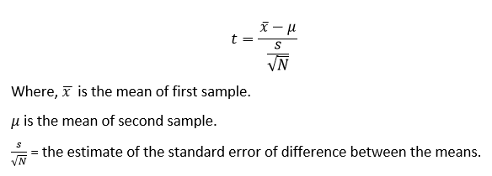
T Distribution
16
Let x have a normal distribution with mean ‘μ’ for the sample of size ‘n’ with sample mean x̄ and the sample standard deviation ‘s’, then the t variable has student’s t-distribution with a degree of freedom, d.f = n – 1. The formula for t-distribution is given by;

Slide 18
T Distribution
17
Properties of T Distribution
It ranges from −∞ to +∞.
It has a bell-shaped curve and symmetry similar to normal distribution.
The shape of the t-distribution varies with the change in degrees of freedom.
The variance of the t-distribution is always greater than ‘1’ and is limited only to 3 or more degrees of freedom.
When to use the t-Distribution: Student's t Distribution is used when :
The sample size is 30 or less than 30 and the population standard deviation(σ) is unknown.
The population distribution must be unimodal and skewed.

Slide 19
T Distribution
18
Applications
Testing a Population Mean: Determine if a sample mean significantly differs from a known or hypothesized population mean.
Comparing Two Means: Evaluate whether two independent or paired samples have different means.
Testing Correlation: Assess if the correlation coefficient between two variables significantly differs from zero.
Testing for the hypothesis of the difference between two means having the dependent sample.

Slide 20
T Distribution
19
Limitations
Assumes Normality: The t-distribution relies on the assumption that the underlying population is normally distributed. Significant deviations can lead to inaccurate results.
Less Useful for Large Samples: As the sample size increases, the t-distribution approaches the normal distribution, making the latter more suitable for large datasets.
Sensitive to Outliers: Extreme values can distort results, especially in small samples where the t-distribution’s heavy tails amplify their effect.
Requires Random Sampling: Valid conclusions depend on random, independent observations. Violating these assumptions reduces the reliability of inferences.

Slide 21
RSE (Residual Standard Error)
20
Definition: The RSE is the standard deviation of the residuals (the differences between the observed values and the values predicted by the model). It provides an absolute measure of the typical distance that the data points fall from the regression line.
Units: RSE is measured in the same units as the dependent (response) variable. For example, if you are predicting sales in dollars, the RSE will be in dollars.
Interpretation: A smaller RSE indicates a better-fitting model, as it means, on average, the observed values deviate less from the predicted values.
Analogy: The RSE is like knowing the exact speed a car is traveling (e.g., 72 MPH faster), providing a concrete, absolute measure of the error.

Slide 22
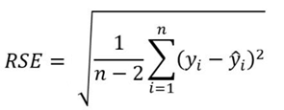
RSE (Residual Standard Error)
21
The RSE is the standard deviation of the residuals (the differences between the observed values and the values predicted by the model). It provides an absolute measure of the typical distance that the data points fall from the regression line.
Units: RSE is measured in the same units as the dependent (response) variable. For example, if you are predicting sales in dollars, the RSE will be in dollars.
Interpretation: A smaller RSE indicates a better-fitting model, as it means, on average, the observed values deviate less from the predicted values.
Analogy: The RSE is like knowing the exact speed a car is traveling (e.g., 72 MPH faster), providing a concrete, absolute measure of the error.

Slide 23
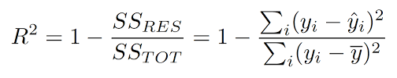
R² (R-squared)
22
Definition: R² (also known as the coefficient of determination) is a relative measure that indicates the proportion of the variance in the dependent variable that is predictable from the independent variable(s). It is calculated as 1 minus the ratio of the residual sum of squares (RSS) to the total sum of squares (TSS).
Units: R² is a unitless proportion (or percentage), ranging from 0 to 1 (or 0% to 100%).
Interpretation: A higher R² value indicates a better model fit.
R² = 1: The model perfectly predicts the variability in the response variable.
R² = 0: The model explains none of the variability in the response variable (it predicts no better than the mean of the dependent variable).
An R² of 0.61 means that 61% of the variability in the dependent variable is explained by the model.

Slide 24
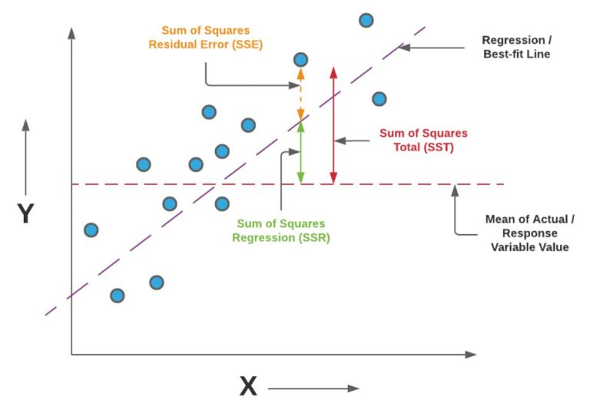

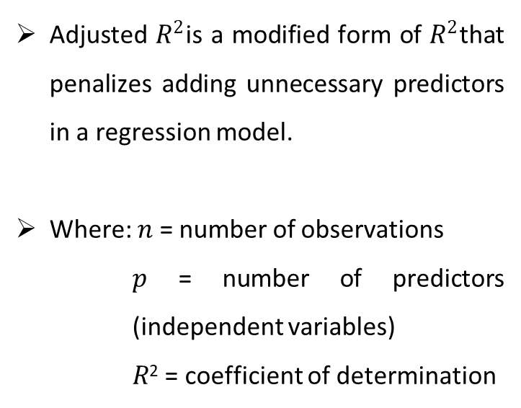
R² (R-squared)
23
Analogy: R² is like knowing a car went "80% faster" – it's a relative measure that sounds impressive, but its practical significance depends on the original context/scale.
Adjusted $R^{2}$is a modified form of $R^{2}$that penalizes adding unnecessary predictors in a regression model.
Where: 𝑛 = number of observations
𝑝 = number of predictors (independent variables)
𝑅² = coefficient of determination

Slide 25
RSE Vs R²
24
Characterists | R Squared | Standard Error
Objective | The objective of R squared is to determine how much is the strength of relationship between Independent and Dependent variables | The objective of this metric is to find the average distance between actual values and the predicted values through which the regression line passes.
Measurement Focus | R-Squared lies between 0 and 1. | Standard error does not lie between 0 and 1.
Purpose and use | R2-squared is used for comparison between two models. | Helps to determine the precision of predictions
Interpretation | Higher the value more is the variability between dependent and independent variable. | Lower the value better is the model.
Relationship Between the Two Metrics | There is no formula-based relationship but as one decreases the other one increases and vice versa | There is no formula-based relationship but as one decreases the other one increases and vice versa

Slide 26
Applications of the Topic
25
Here are applications:
Model's natural measurements: height, weight, blood pressure, IQ, exam marks etc.
Used to model measurement errors and noise in instruments and sensors.
Forms the basis of many statistical tests (z-test, many parametric tests assume normality).By Central Limit Theorem, sample means of many distributions tend to be normal → used for confidence intervals and hypothesis testing.
Used in quality control (control charts, process variation).Used in finance to approximate asset returns and risk modelling.
Used when sample size is small and population standard deviation (σ) is unknown.

Slide 27
Applications of the Topic
26
Here are some more applications:
Construction of confidence intervals for the mean when 𝑛n is small.
One-sample and two-sample t-tests for comparing means (e.g., before vs after treatment).Testing regression coefficients (slope, intercept) in linear regression → each coefficient’s t-statistic follows a t-distribution under assumptions.
Robust when data is approximately normal but sample size is limited (like < 30).
Used as an estimate of the true error standard deviation (σ).
Helps compare how well different regression models fit the data (lower RSE is better, other things equal).
Measures goodness of fit of regression.

Slide 28
Summary of the Lecture
27
In this lecture, we studied how the Normal distribution is used to model natural continuous data (like height, weight, exam marks) and measurement errors, and how, via the Central Limit Theorem, it underpins confidence intervals and many hypothesis tests.
We then saw that the t-distribution is used when the sample size is small and the population standard deviation is unknown, especially in t-tests and in testing regression coefficients. In the context of regression, we introduced RSE (Residual Standard Error) as an estimate of the average prediction error in the same units as the response variable, and R² (Coefficient of Determination) as a measure of how much of the variation in the dependent variable is explained by the model.

Slide 29
Next Lecture
28
In next lecture, we are going to cover:
K-Nearest Neighbor Classifier
Maximum Margin Classification

Slide 30
Quiz/ FAQ’s
29
What is the Normal distribution?
Give two real-life examples where Normal distribution is applicable.
What does the t-distribution represent?
When do we use t-distribution instead of Normal distribution?
Define RSE in regression.
Define R² and explain what it measures.
What is the range of R² and what do its values indicate?
Why is RSE measured in the same units as the response variable?
How is R² different from Adjusted R²?Why is t-distribution preferred for small sample mean estimation?

Slide 31
References/ Articles/ Videos
30
Text/ Reference Books
T1 | Massaron, L., & Boschetti, A. (2016). Regression analysis with Python. Packt Publishing Ltd.
T2 | Jajuga, K., Sokolowski, A., & Bock, H. H. (Eds.). (2012). Classification, clustering, and data analysis: recent advances and applications.
T3 | Bishop, C. M., & Bishop, H. (2023). Deep learning: Foundations and concepts. Springer Nature.
R1 | Matloff, N. (2017). Statistical regression and classification: from linear models to machine learning. Chapman and Hall/CRC.
R2 | Jajuga, K., Sokolowski, A., & Bock, H. H. (Eds.). (2012). Classification, clustering, and data analysis: recent advances and applications.
R3 | Vishnoi, V. K., Chauhan, N. R., & Kumar, K. (2024). An introduction to deep learning. Xoffencerpublication.

Slide 32
Faculty-curated videos, NPTEL, Coursera, LinkedIn, or other relevant learning resources
31
https://youtu.be/lqeUEVVIDD0
https://youtu.be/QxqxdQ_g2uw
https://www.coursera.org/learn/ai-for-real-world-intelligence-systems?source=admin-share
https://www.coursera.org/learn/ai-for-real-world-intelligence-systems?source=admin-share
https://www.coursera.org/learn/deep-learning-applications-in-vision?source=admin-share
https://www.coursera.org/learn/deep-learning-applications-in-vision?source=admin-share
https://www.coursera.org/learn/ismdl?source=admin-share
https://youtu.be/Q-TtIPF0fCU

Slide 33
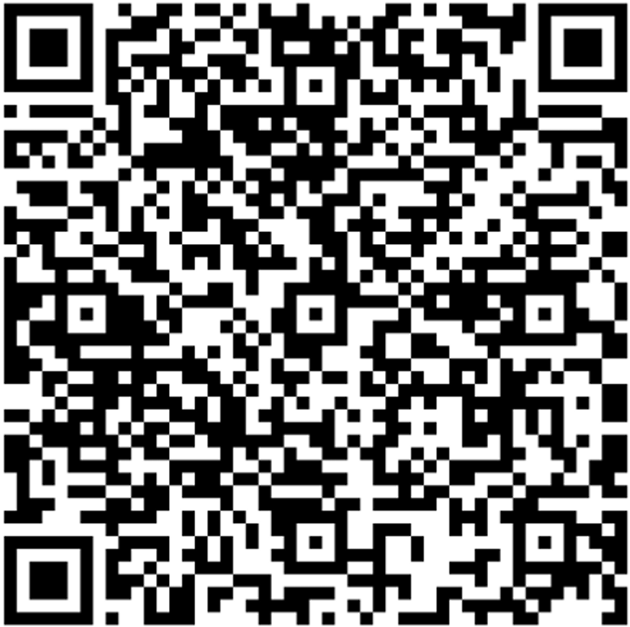
32
Class-Wise Feedback
Note: Scan this QR code to provide anonymous feedback.

Slide 34
33
Thank You
For queries
Email: siddharth.e12853@cumail.in

